Slide 1
Writing and Reading Toolkits
Using Tools Wisely to Support Writing and Reading Instruction and Student Growth

Slide 2
Why Toolkits?
Help kids remember what has been taught
Lifts the level of rigor
Gives access to a wide range of learners
Supports your teaching within your conferring and small groups
Helps maximize instruction time during independent work times

Slide 3
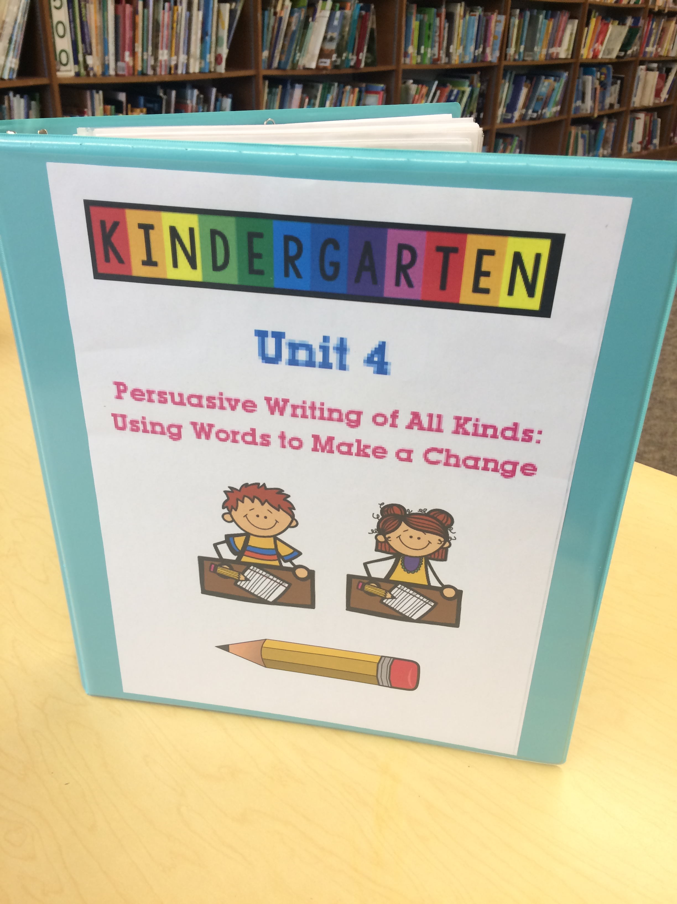
What's in a toolkit?
Student writing exemplars
Writing demonstration texts
Checklists
Mentor texts
Mini-charts
Micro-progressions
Goal-Making Tools
Small Group Planning Notes
Conferring Notes
YOU!

Slide 4
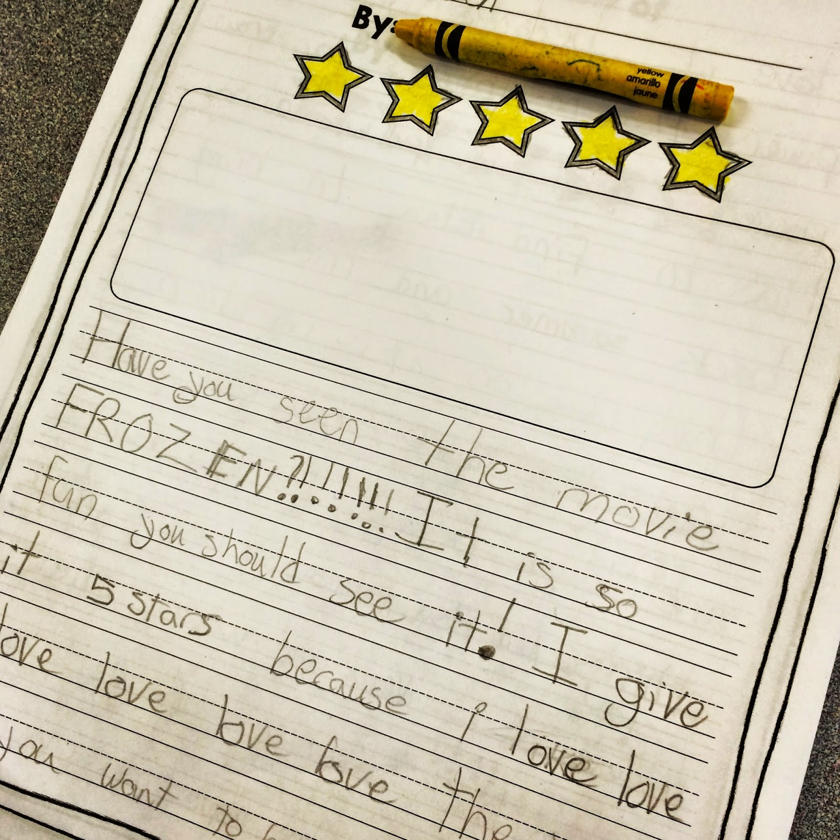
Tool #1: Writing Samples
Can be either teacher created or authentic samples of student work
Serves as a concrete example of what a given writing genre and/or writing technique could look like
Provides support for writers
May be interactive

Slide 5
Exemplar vs. Demonstration Texts
Exemplar
Text used as a model
Has all the things in it from the mentor text that you want kids to do
Above student level
Annotated but not worked on together.
Demonstration
At student level
“Working” version
To show kids how to fix something
Use it in your conferring and small groups to show how to make a piece better (interactive)

Slide 6
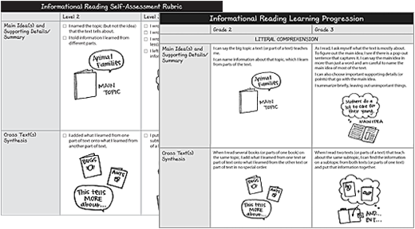
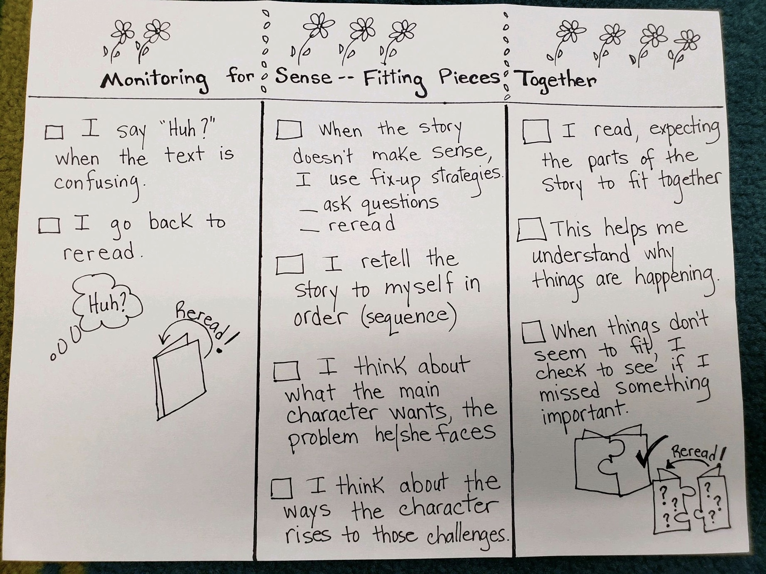
Tool #2:Checklists and Micro-progressions
Designed specifically for student use for self-evaluation and goal setting
Can be found in Writing Pathways and on Heinemann website
Illustrated checklists are available at all grade levels!(only on Heinemann website 3-5)
Refer to them often
Display your checklists
Give students copies
Cut them up
Connect to your read-aloud work

Slide 7
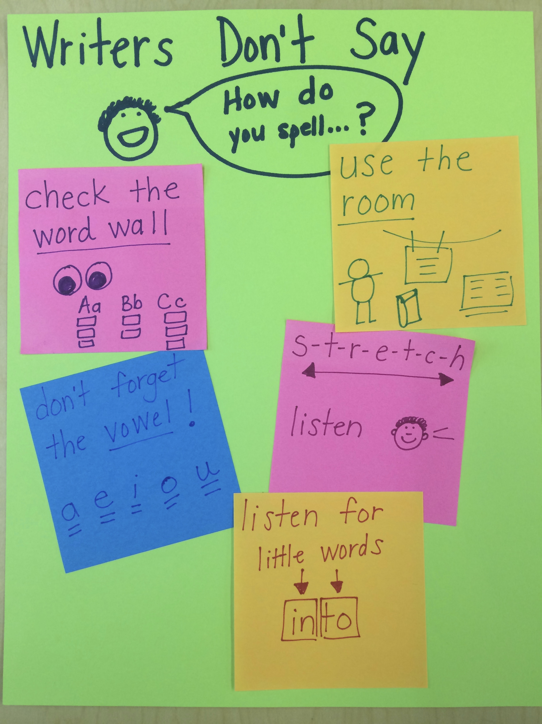
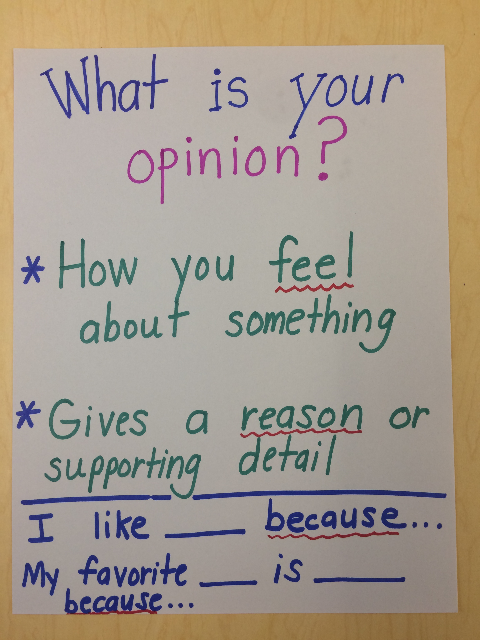
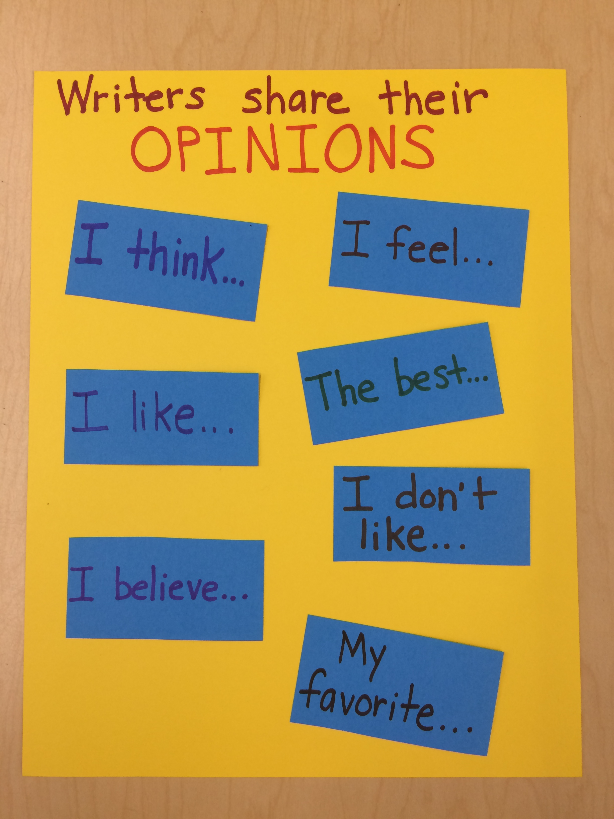
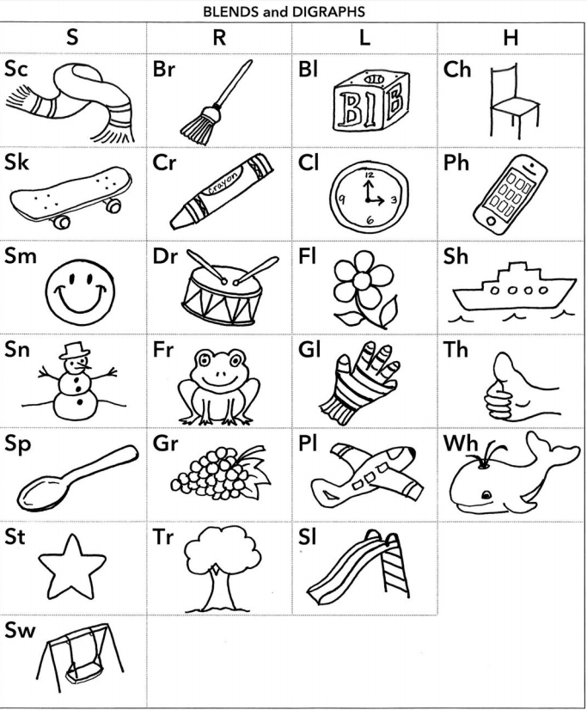
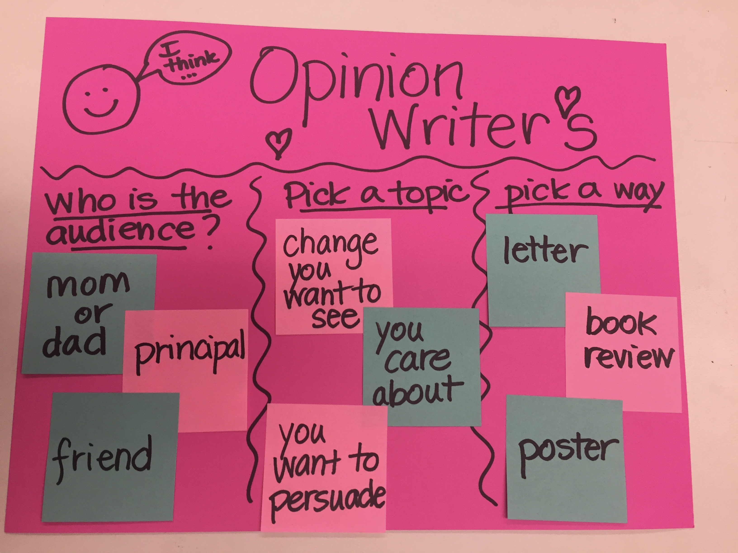
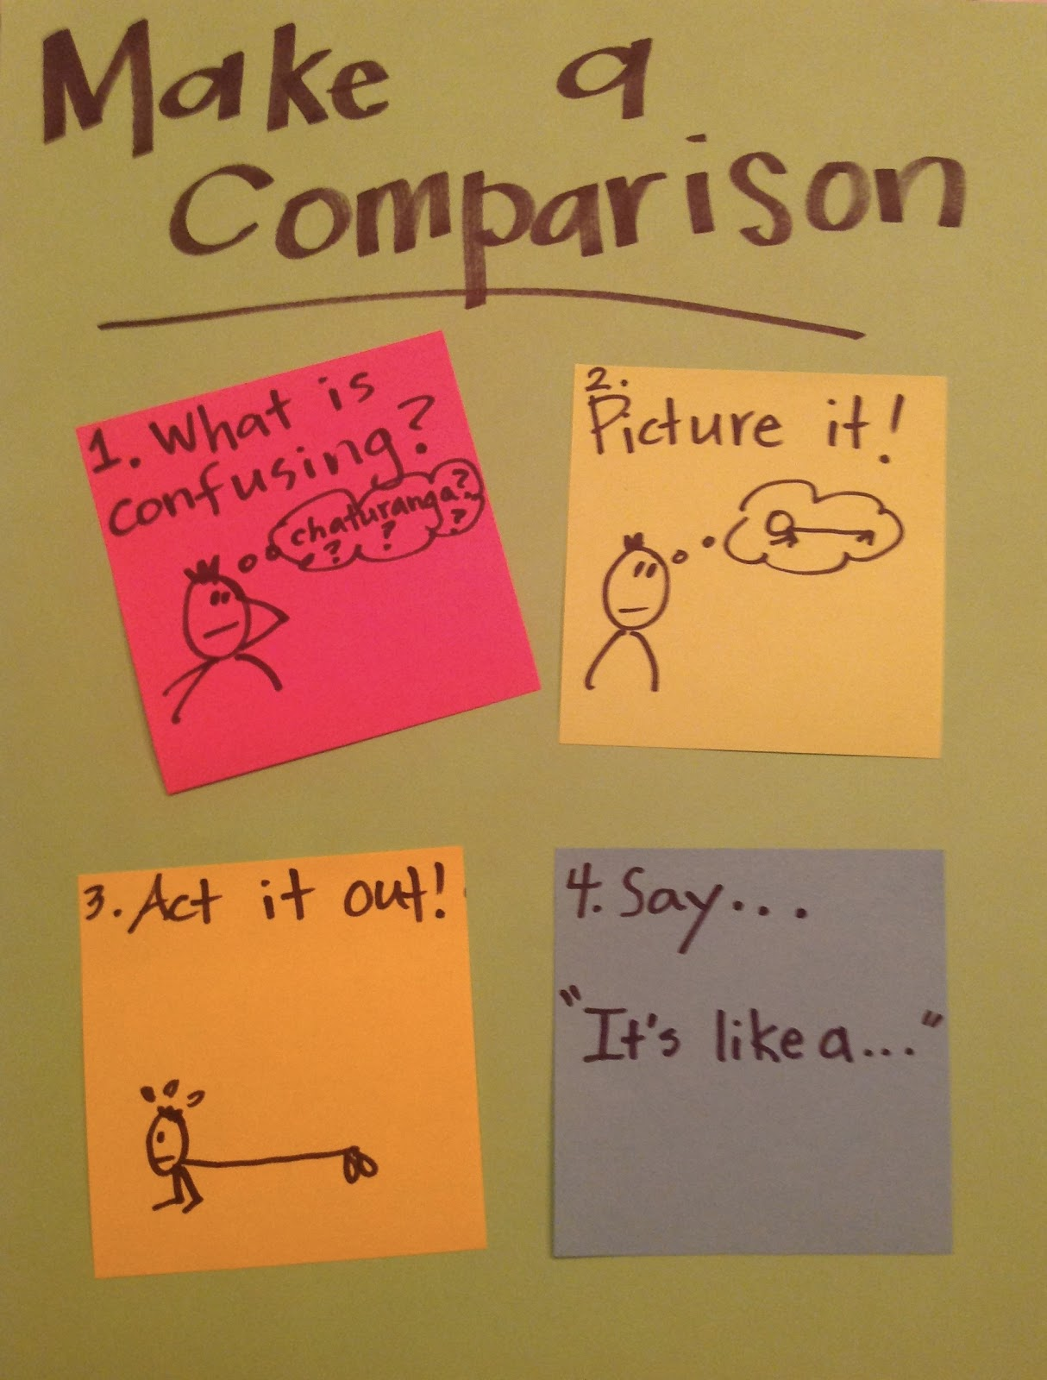
Tool #3: Mini Charts
Smaller versions of charts already
being used in the room:
Anchor charts
Lesson-specific charts
Process charts
Strategy charts
Grammar charts
Routine charts
Can be used for small
group work or conferences

Slide 8
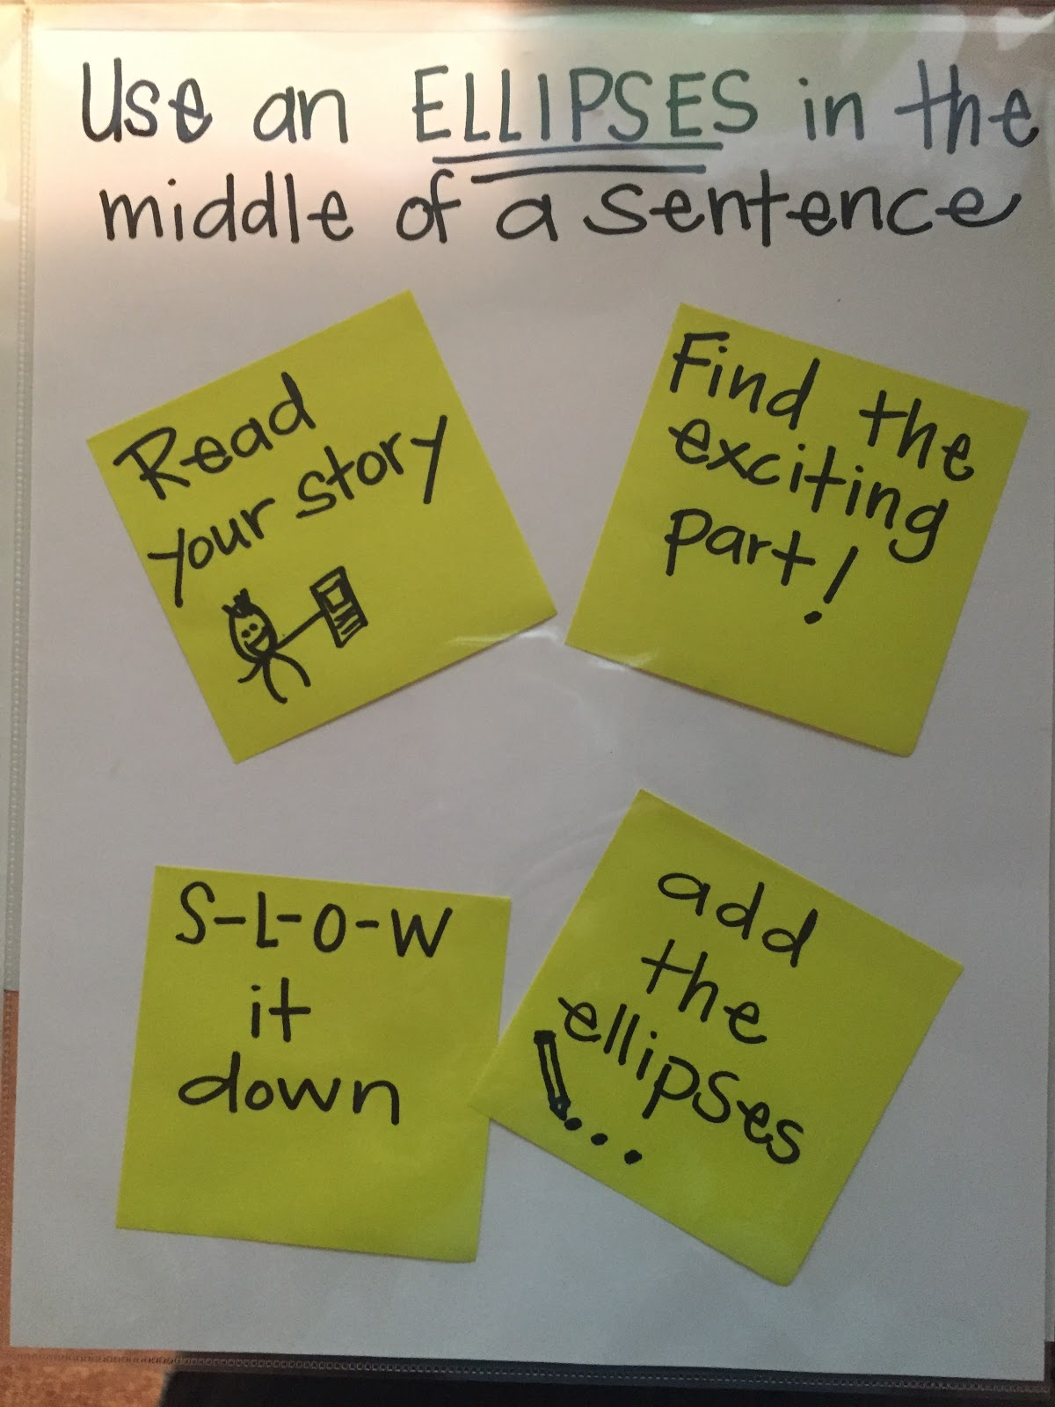
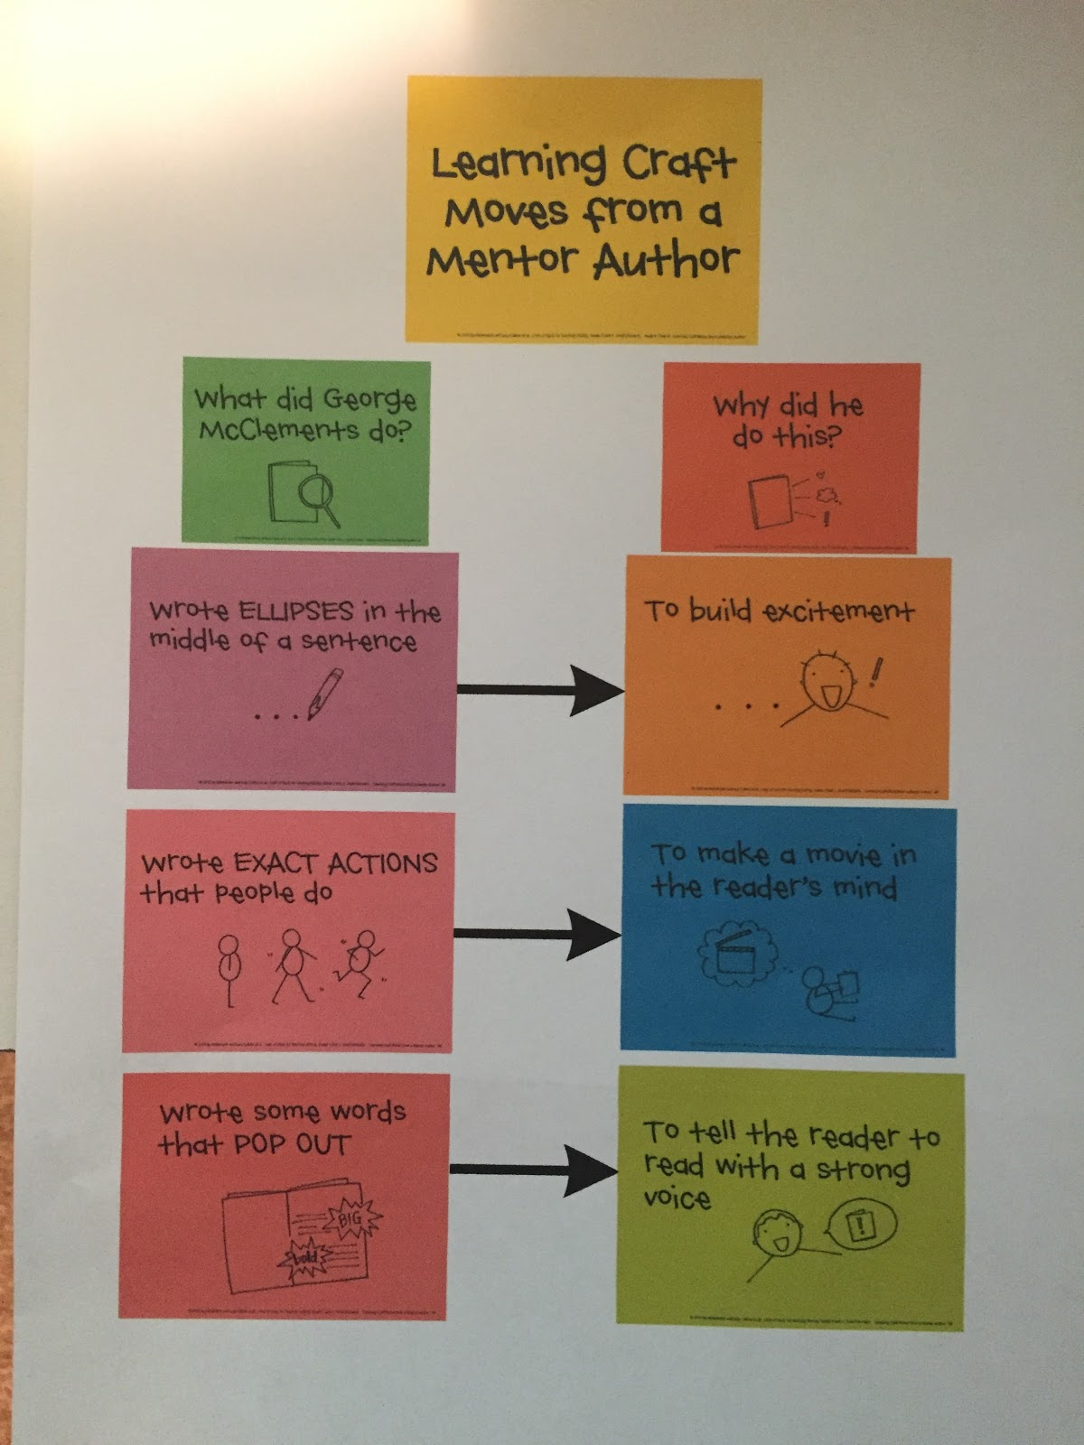
Types of Charts
Repertoire Charts
Records a list of strategies that helps students work toward a BIG skill
All the ways a writer can do something
Process Charts
Takes a big skill and breaks it down into the steps students would take to gain that skill

Slide 9
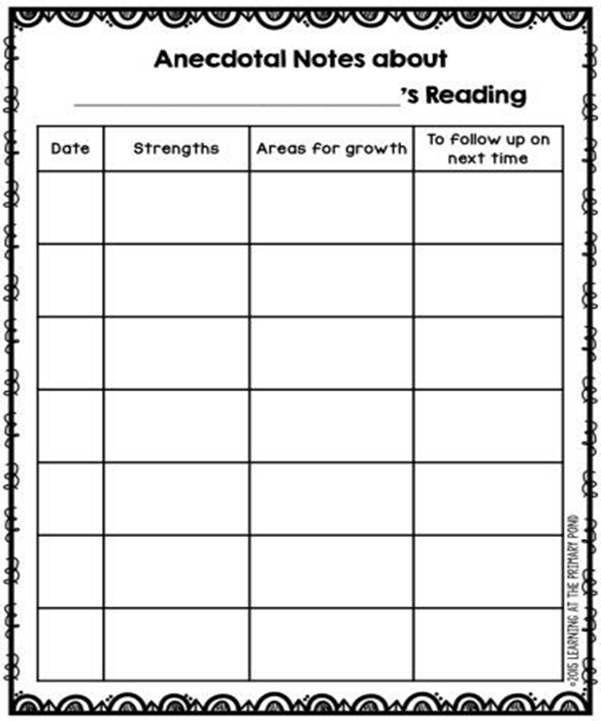
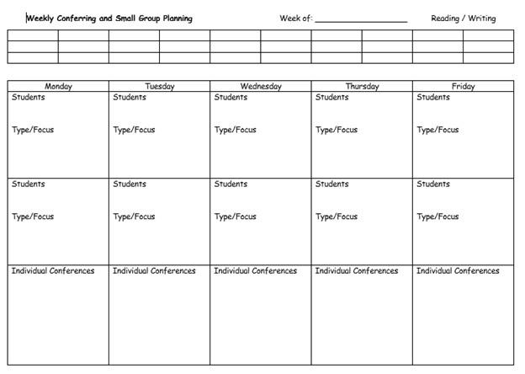
Tool #4: Conference and Small Group Notes
Kids write to be seen and heard. They need to see that their stories matter. BE PRESENT
What’s your purpose? Use the notes you take.
Choose a form you think will work best for you. Change it and make it your own.
“Do the best you can until you know better. Then when you know better, do better.” -Maya Angelou

Slide 10
Toolkit Tips:
Balance pictures and words
Try to keep a tool to no more than
3-5 components (strategies, steps)
Have a clear title to let children know
what the tool is for
Keep it simple - less is more!
If you don’t use it - get rid of it

Slide 11
Example of a Toolkit!https://youtu.be/mrcZurfeaDY

